Slide 1

AquaFaze
Stay Hydrated!! Stay Motivated!!
Academic project

Slide 2


Team
Subhodeep Ghosh
Research
Mathematical calculations
Machine Learning models
Algorithm designer
ML enthutiast

Slide 3

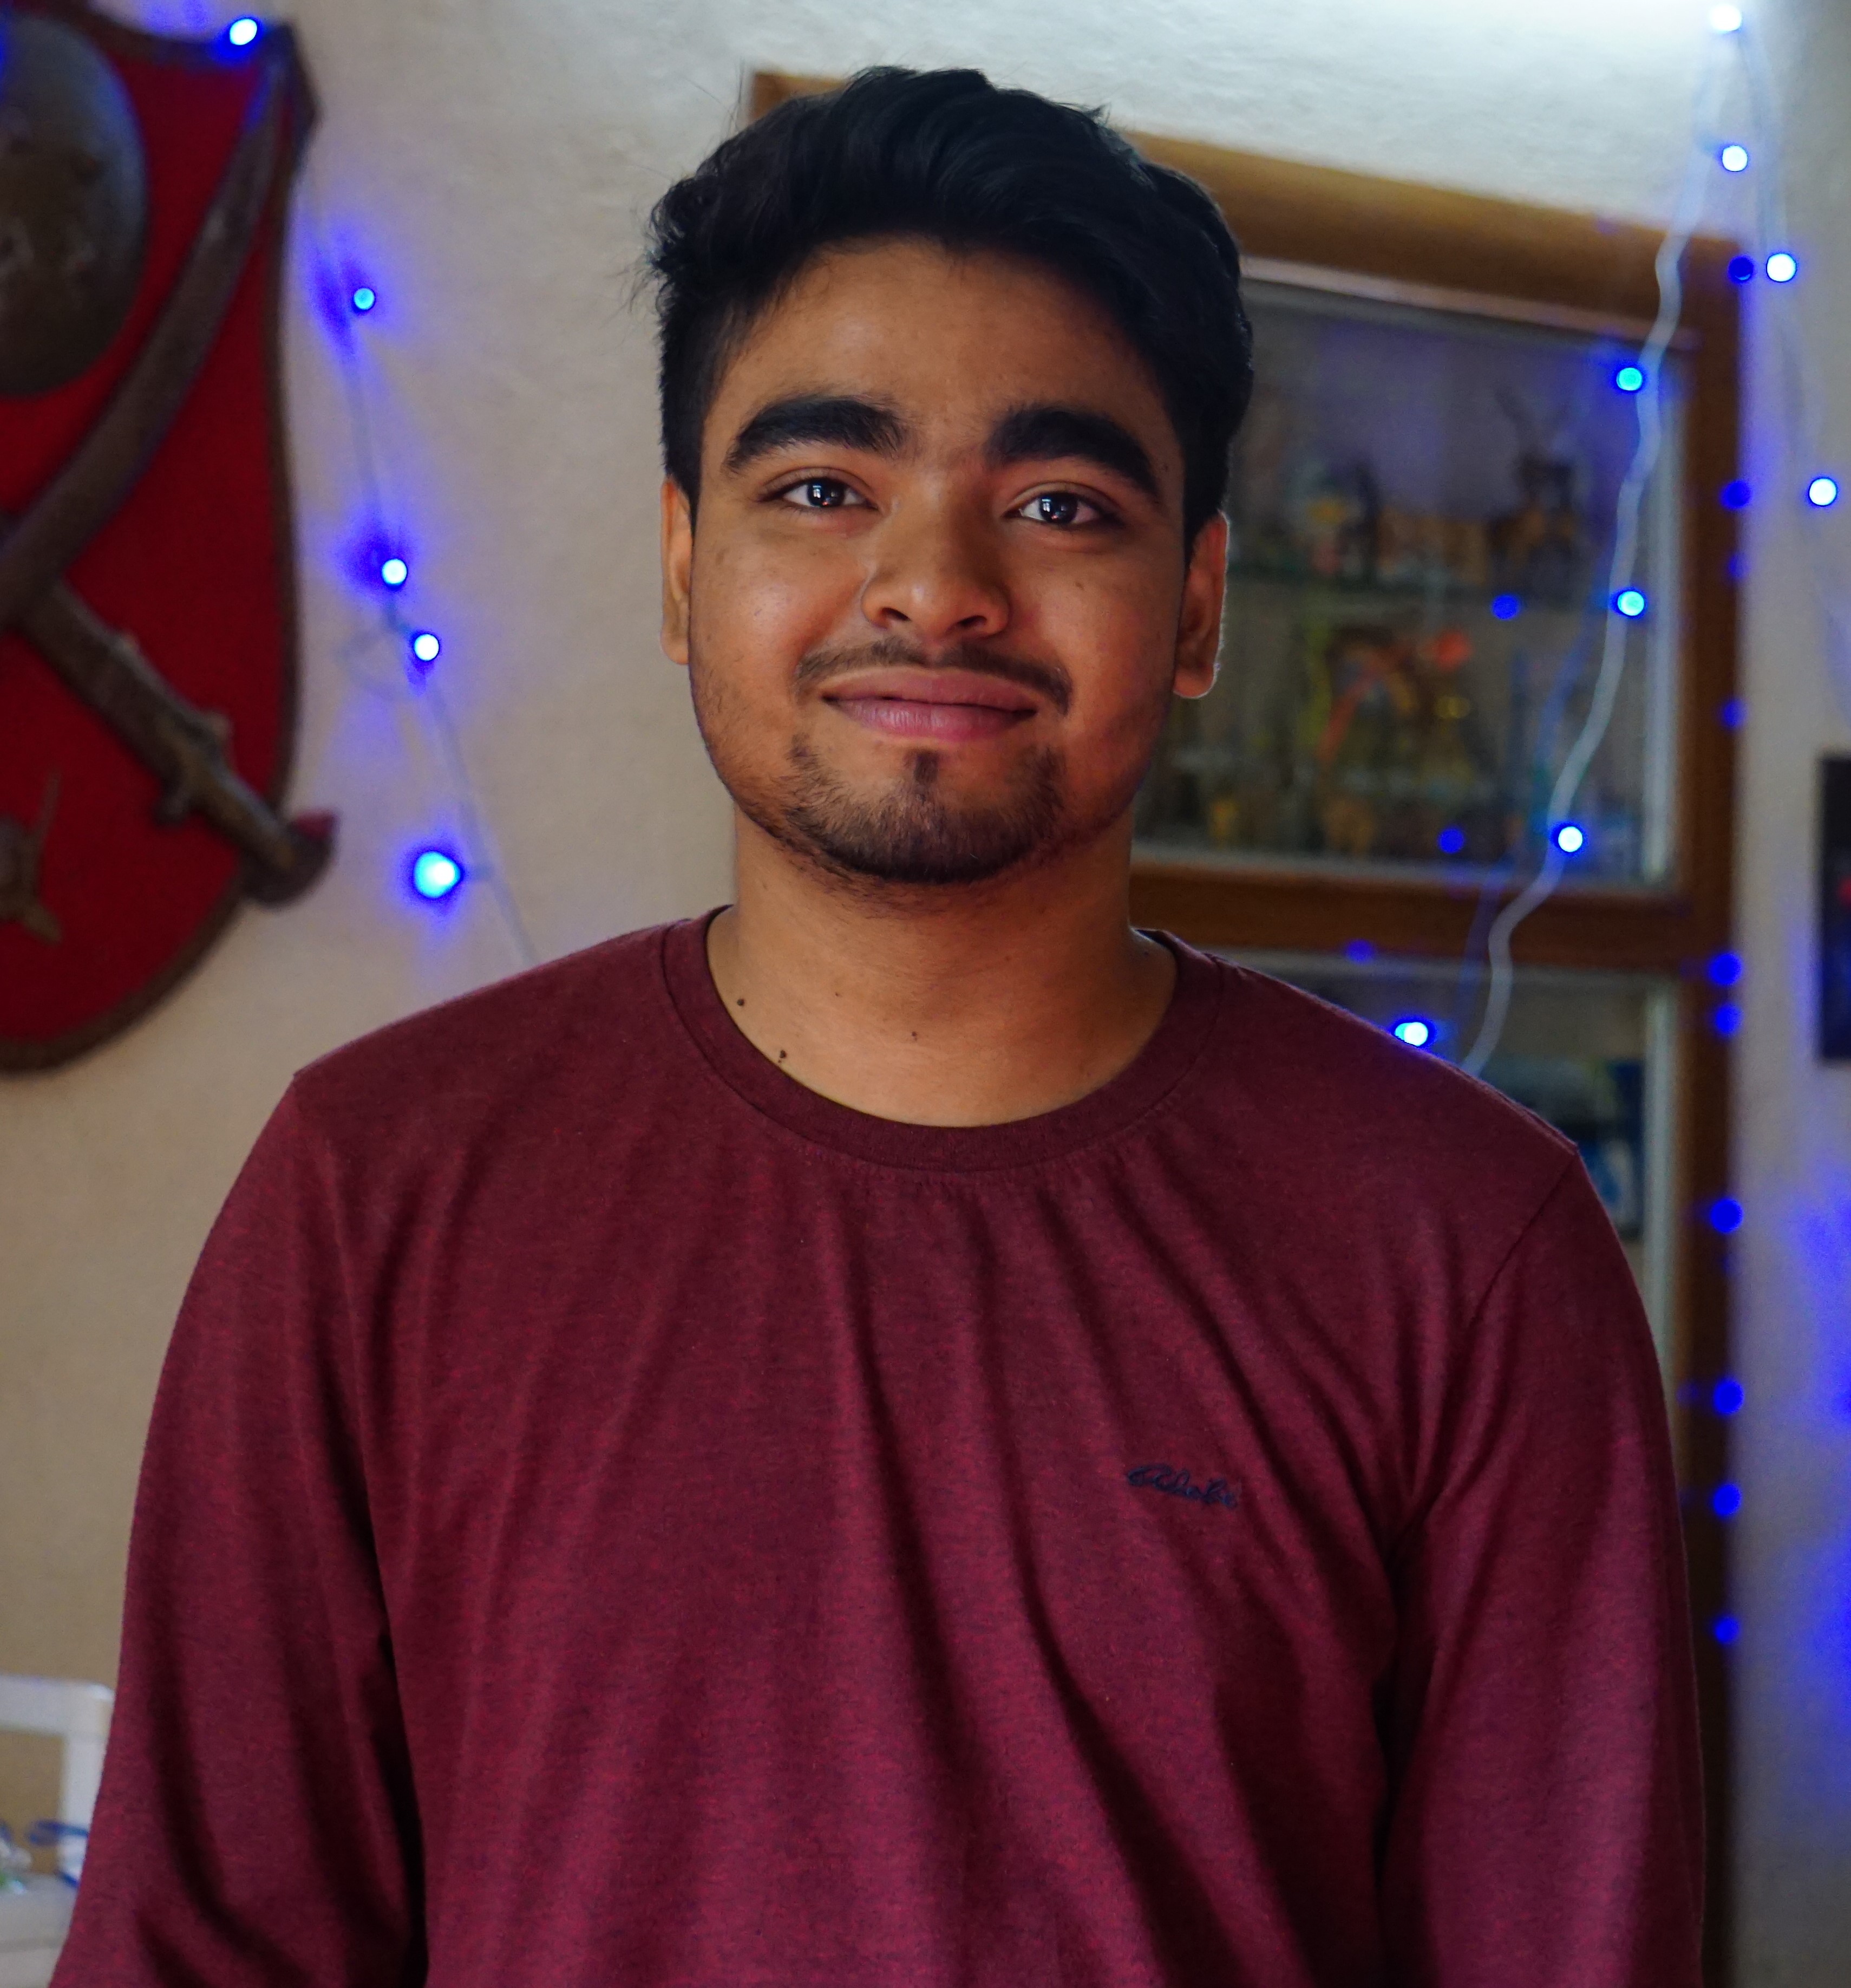
Team
Akash Ranjan Mandal
Frontend development
Graphic Design
Content Writer
Frontend Developer

Slide 4

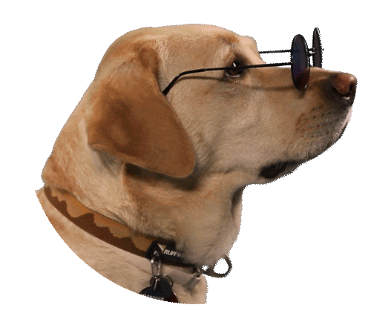
Team
Souvik Ghosh
Backend Development
Connection Integrator
Framework expert
Hii
I’m souvik
Backend Developer

Slide 5


Team
Poulami Kayal
Dataset modification
Database management
Data pre processing
Database Manager

Slide 6

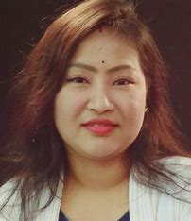
Team`
Dr. Usha Rani Gogoi
Detailed guidance
Research motivation
Inspiration for creative thinking
Project Guide

Slide 7
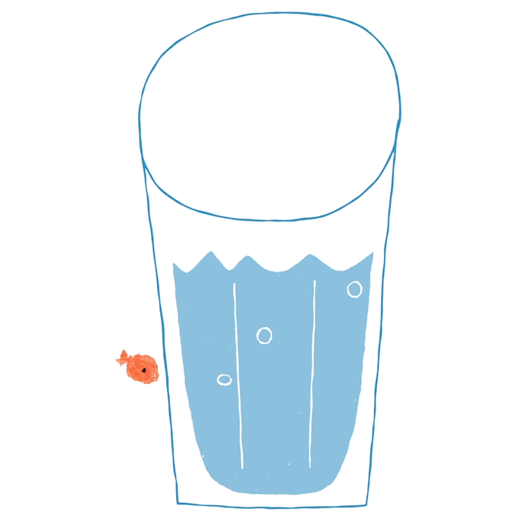
Abstract
An AIML based project based website to detect bodily hydration requirement by capturing photo of your face using your camera/webcam, there are few more features:
Detailed Analysis
Activito!
Gel- chatbot
Business Space

Slide 8

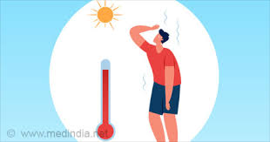
Problem Statement
Dehydration
Indifference
Dehydration causes numerous deaths all around the world, specially in summer
Yet, people are unaware of how dire the consequences are

Slide 9
Existing Softwares
01
Time Consuming
02
More Parameters
03
Body to body variation
04
No post calculations
Click face image for hydration data display
Comprehensive parameter analysis for holistic hydration assessment
Accurate data tailored to diverse human bodies
Previous hydration data used to show recent post-calculations

Slide 10
Open Your Eyes !!
01
518,000
02
75% Americans
03
almost 530 people
04
Water Consumption Disparity in FY 2022
people hospitalised[1]
are chronically dehydrated.[2]
were reported dead due to heatwaves in 2020 [3]
adults aged 30-44 consumed 2.26L of water daily, while those under 19 consumed 1.97L [4] . Adult recommendations: 2.7L women, 3.7L men. [5]

Slide 11
How dehydration affects
detoxification
Decreased brain volume
Dehydration impairs liver's detoxification ability, hindering toxin elimination
Dehydration heightens gastritis and ulcer risk; hydration protects stomach lining
Constipation
gastritis and ulcers
Inadequate hydration can lead to constipation due to water absorption
Dehydration heightens gastritis and ulcer risk; hydration protects stomach lining

Slide 12

Proposed Methodology
We are developing an ML-based solution where users can simply upload a picture of their face and provide their current latitude and longitude. This eliminates the need for tedious form filling, ensuring a seamless and engaging user experience.

Slide 13
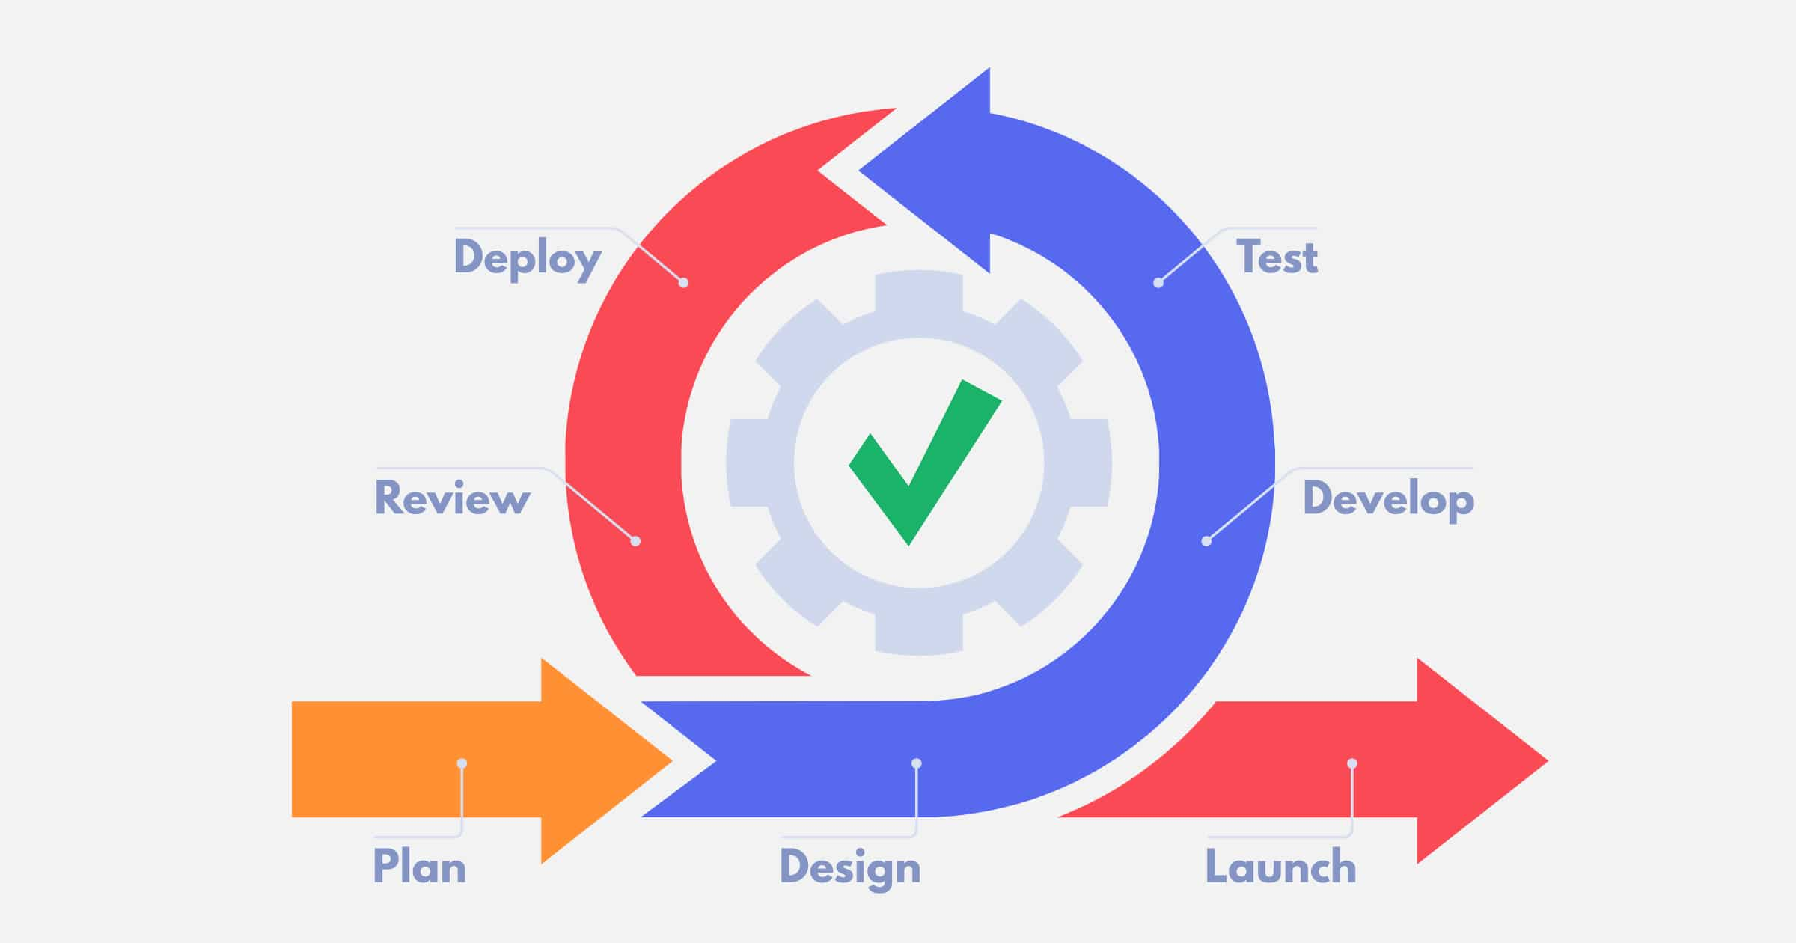
Iterative Model
We have used Iterative model because
We are in a learning arc
Had sufficient time
Was unsure about the final product but had a ghastly idea
Had the basic requirement figured out and added other requirements along the way

Slide 14
ML pipeline
Detailed overview of machine learning models

Slide 15
Other features
Detailed Analysis
Activito!
Gel
Purely mathematical calculation to get actual hydration requirement and compare to the quick one
ML model to predict wheather you can sustain the activity you wanna do as long as you wanna do
A precius chatbot to answer all of your queries related to our website workflow or taboo things

Slide 16
Parameters
01
02
Age
Gender
03
Ethnicity
04
BMI
05
Location based Parameters

Slide 17
Age
Age vs Hydration requirement follows the ideal normal distribution

Slide 18

Gender
Average male body requires higher hydration level than average female body
Male >Trans gender >Female
(according to physical condition)

Slide 19

Ethnicity
Ethnicity directly affects hydration intake
ps: We have generalized the ethnicity groups which somewhat affects the accuracy

Slide 20
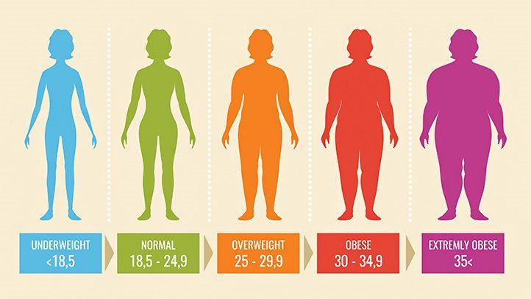
BMI
The higher the BMI is, the person tends to overweight, therefore requiring more water intake to loose fat

Slide 21
Location
01
02
Weather
Sky
03
Humidity
04
Temperature
05
Relative temperature
Mist, Fog , Haze
Cloudy, Sunny, Rainy
1 : 100
>10 : 100
>10 : 100

Slide 22
Temperature and feels like
65%
Lower
Areas further than the equator tends to have lower hydration requirement
35%
Higher
Areas closer to the equator tends to have higher hydration requirement

Slide 23

Please Look at the Board

Slide 25
Lets Look at AquaFaze
A visually and viscerally impelling website

Slide 26
Let’s look at Context level DFD
We have a separate website fo

Slide 27
Backend Architechture

Slide 28
Future Scope
“When a small day-dream turns out to be a technical nightmare”

Slide 29
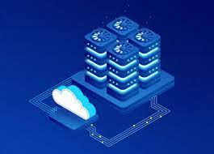
Future Plans
Thorough research and dataset collection(with legal authority and proper research, survey)

Slide 30
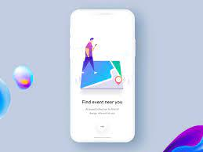
Future Plans
Dedicated Application

Slide 31
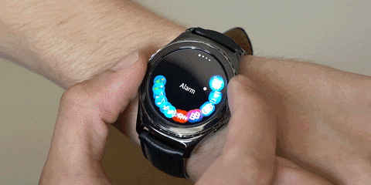
Future Plans
IOT device (smart-watch)

Slide 32
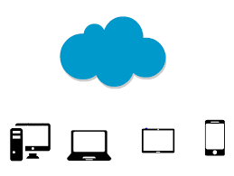
Future Plans
Web hosting and cloud deployment

Slide 33

Future Plans
ML model improvements (Golden ratio, regional data collection, big data implementation)

Slide 34
Conclusions
Lets wrap up all the things we have showcased thus far…!!

Slide 35
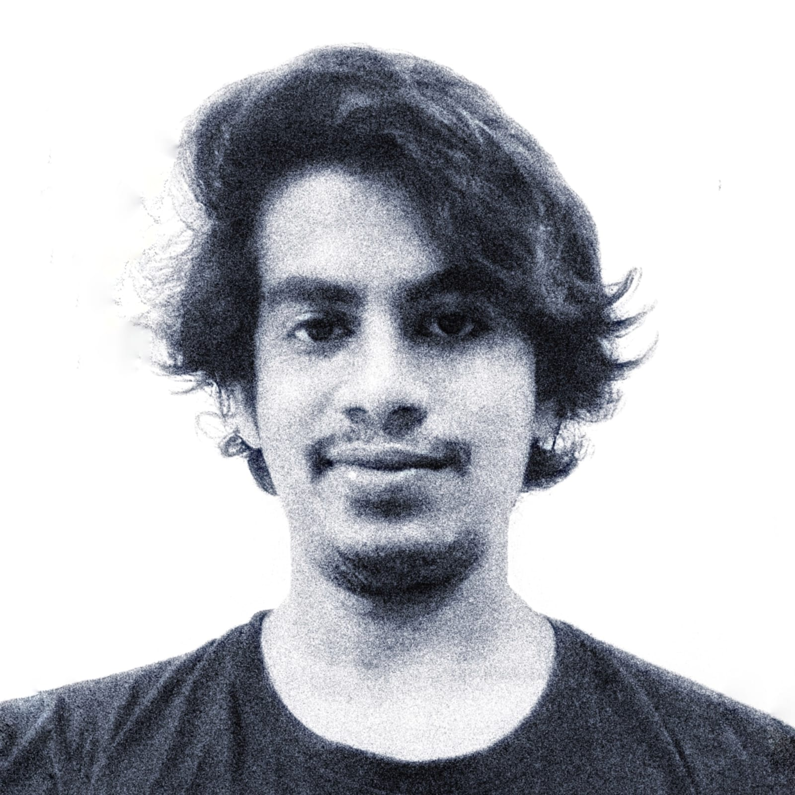
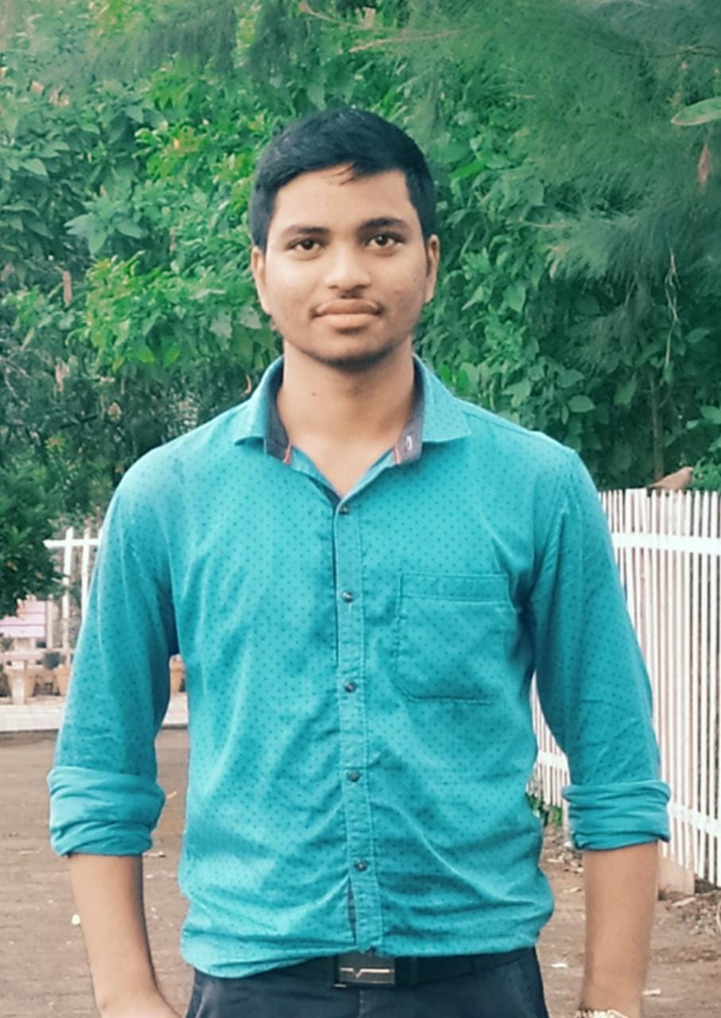
Special Thanks
Subhajit paul
Rajkumar Maity
For giving new directions and naming new technologies
For Saving us from various errors, occurred

Slide 36
References
[1] https://www.everydayhealth.com
[2] www.ncbi.nlm.nih.gov
[3] www.statista.com
[4] www.statista.com
[5] www.healthline.com
[6](www.webmd.com)
[7](www.mayoclinic.org)
[8] (www.medscape.com)
[9](www.nih.gov)
[10](www.cdc.gov)
[11](www.who.int)
[12](www.healthline.com)

Slide 37
References
[13](www.ama-assn.org)
[14](www.hopkinsmedicine.org)
[15] (www.mayoclinicproceedings.org)
[16](www.heart.org)
[17](www.thelancet.com)
[18](www.uptodate.com)
[19](www.cancer.org)
[20](www.healthgrades.com)
[21](www.drugs.com)
[22](www.nlm.nih.gov)
[23] www.medlineplus.gov

Slide 38
References
[24]https://www.ethnicity-facts-[25]figures.service.gov.uk/
[26]https://www.pewresearch.org/
[27]https://www.worldbank.org/
[28]https://www.ohchr.org/
[29]https://en.unesco.org/
[30]https://www.census.gov/
[31]https://www.globalissues.org/
[32]https://worldpopulationreview.com/
[33]https://www.nationalgeographic.com/
[34]https://minorityrights.org/

Slide 39
References
[35]https://www.plannedparenthood.org/
[36]https://www.genderspectrum.org/
[37]https://www.hrc.org/
[38]https://transequality.org/
[39]https://www.apa.org/
[40]https://www.glaad.org/
[41]https://transgenderlawcenter.org/
[42]https://pflag.org/
[43]https://www.thetaskforce.org/

Slide 40
THANKS!
Do you have any questions?
+91 8420894696
AquaFaze.com

